Slide 1


Unit 6.5 Data transfer protocols used by IoT

Slide 2

Unit Goal
This unit aims to introduce the main protocols used in IoT.

Slide 3
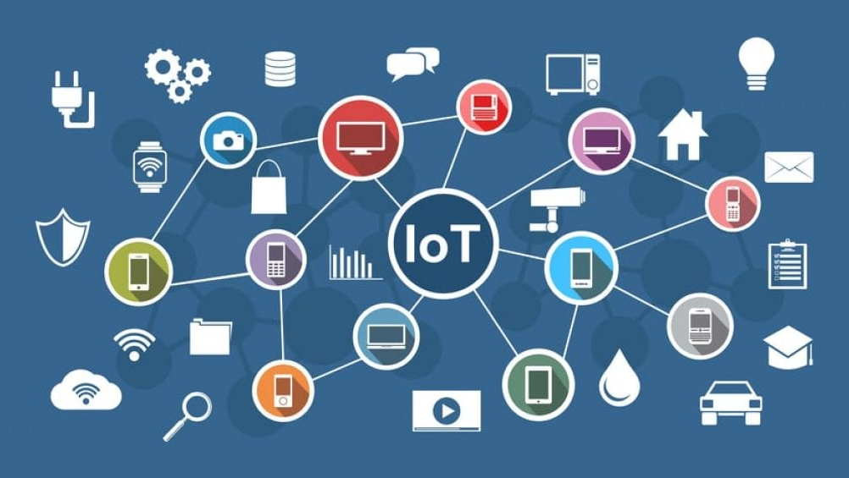
IoT Protocols

Slide 4
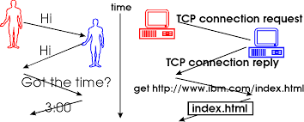
What is a Protocol?
A communication protocol is a system of rules that allows two or more entities of a communications system to transmit information via any kind of variation of a physical quantity.
The protocol defines the rules, syntax, semantics and synchronization of communication and possible error recovery methods.

Slide 5
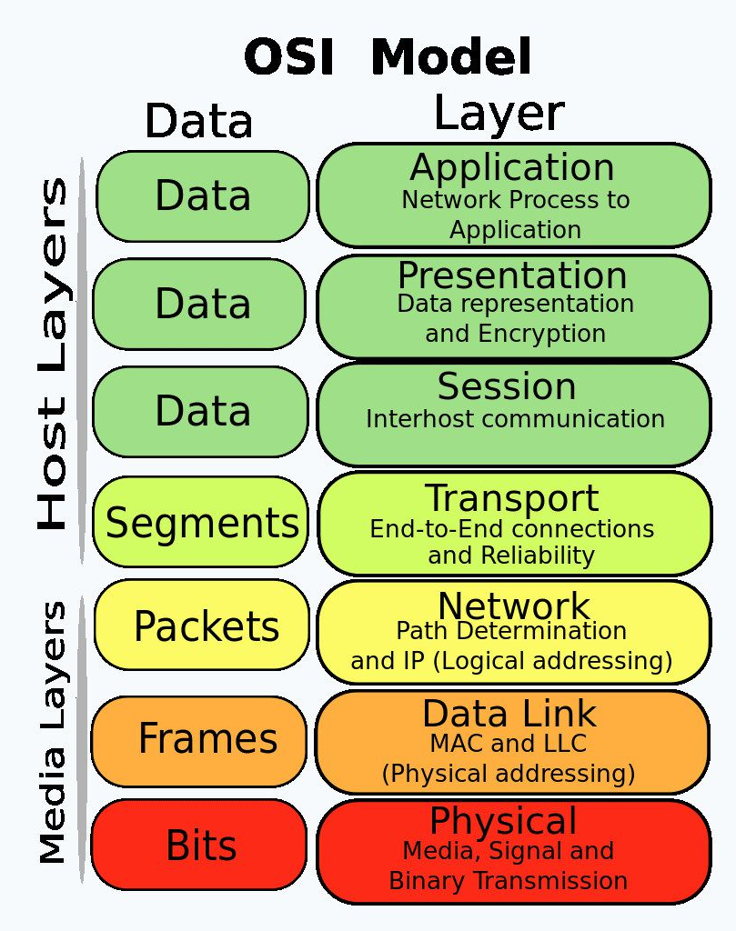
OSI Model
The OSI Model (Open Systems Interconnection Model) is a conceptual framework used to describe the functions of a networking system.
The OSI model characterizes computing functions into a universal set of rules and requirements in order to support interoperability between different products and software.

Slide 6

OSI Model
https://www.youtube.com/watch?v=LANW3m7UgWs

Slide 7
Transport Layer
responsible for logical communications between applications running on different hosts.
The link between the application layer and the lower layers that are responsible for network transmission.

Slide 8
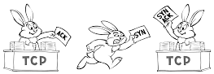
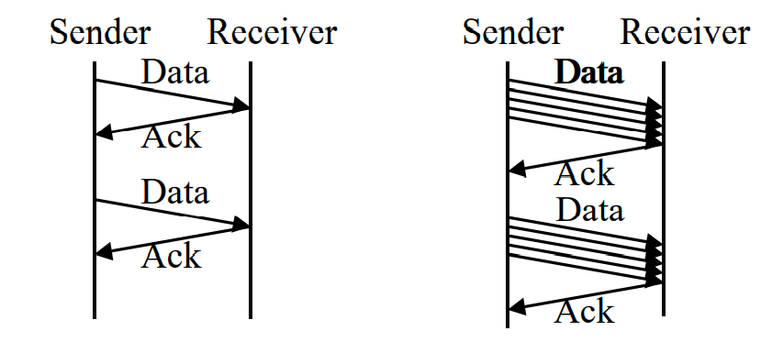
TCP
Establishes a Session
Ensures Reliable Delivery
Provides Same-Order Delivery
Supports Flow Control

Slide 9
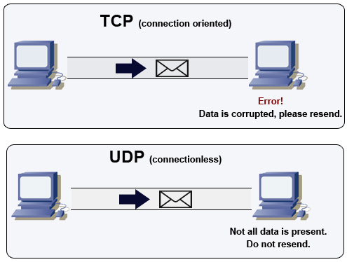
UDP
User Datagram Protocol (UDP/IP) is a connectionless communication protocol located in the transport OSI layer.
It performs better than TCP in environments where other layers can handle errors.
Application Examples: VoIP, Multimedia,, Streaming, etc.

Slide 10
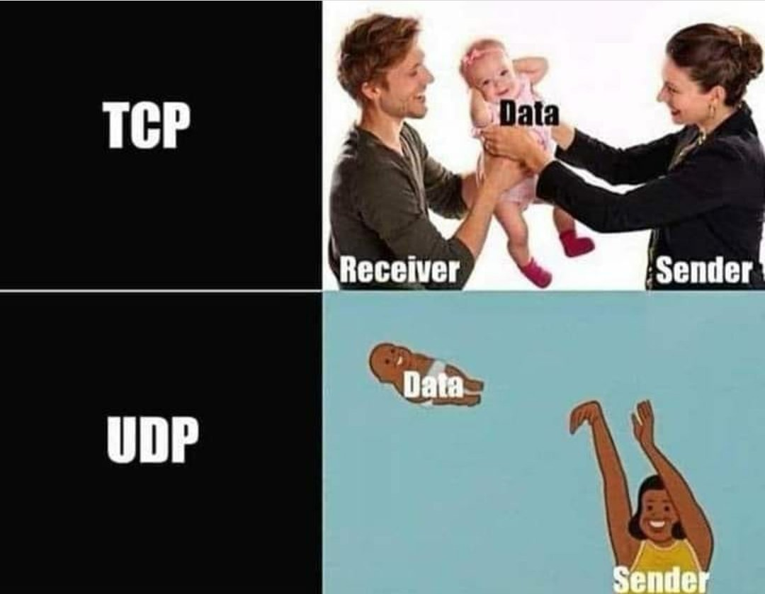

Slide 11
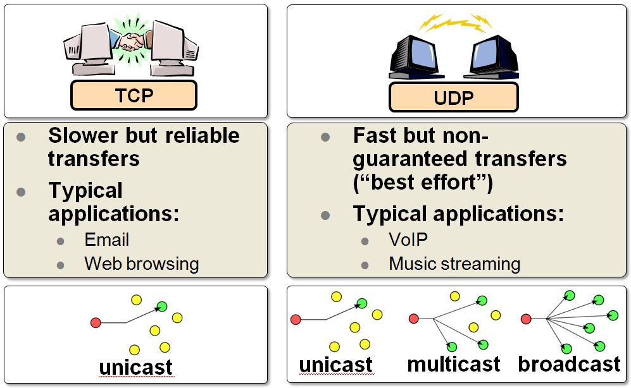
TCP X UDP
TCP: connection-oriented protocol
Path setup before data is sent
Data need not have addressed. The circuit number is sufficient.
Ex: Telephone System
UDP: connection-less protocol
Complete address on each packet
The address decides the next hop at each router.
Ex: Postal System.

Slide 12
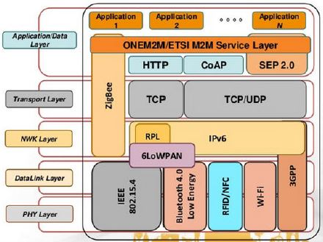
IoT Protocols
Notes:
https://medium.com/@rinu.gour123/4-major-iot-protocols-mqtt-coap-amqp-dds-46016897c3e9

Slide 13
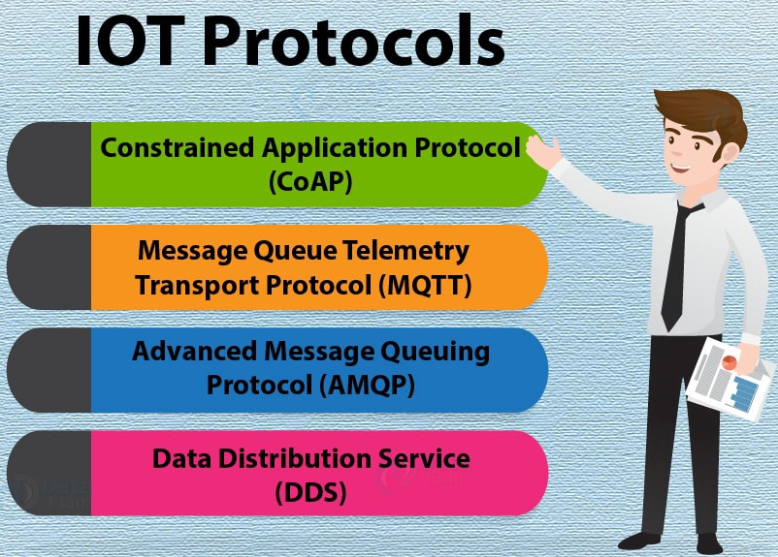
IoT Protocols
Notes:
https://medium.com/@rinu.gour123/4-major-iot-protocols-mqtt-coap-amqp-dds-46016897c3e9

Slide 14
Constrained Application Protocol (CoAP)

Slide 15
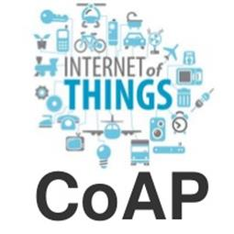
Constrained Application Protocol (CoAP)
CoAP is an internet utility protocol for restricted gadgets.
This protocol is particularly designed for IoT systems primarily based on HTTP protocols.
CoAP makes use of the UDP protocol for lightweight implementation, and RESTful architecture, which may be very just like the HTTP protocol.

Slide 16
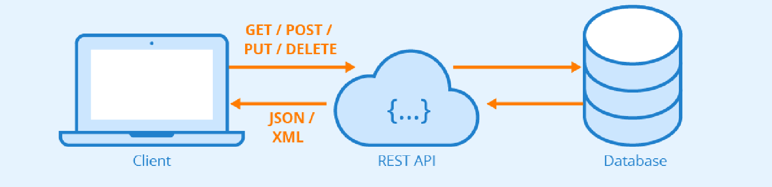
RESTful
REST is an acronym for REpresentational State Transfer and an architectural style for distributed hypermedia systems.
REST is an architectural style, or design pattern, for APIs.
REST resource representations shall be self-descriptive: the client does not need to know if a resource is an employee or a device. It should act based on the media type associated with the resource.

Slide 17
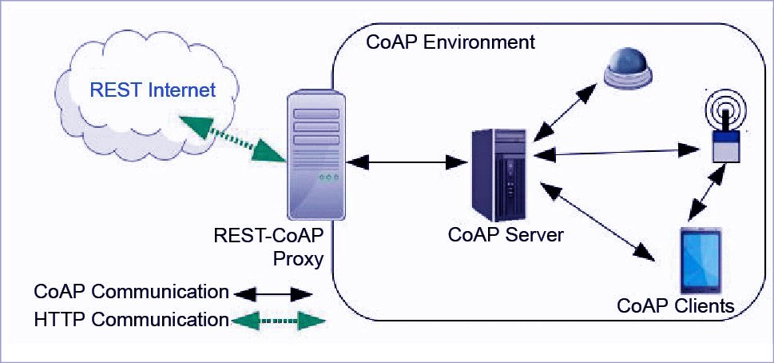
Constrained Application Protocol (CoAP)

Slide 18
Message Queue Telemetry Transport Protocol (MQTT)

Slide 19

Message Queue Telemetry Transport Protocol (MQTT)
MQTT (MQ Telemetry Transport) is a lightweight messaging protocol designed for high-latency, low-bandwidth, and unreliable networks.
It consumes very little power on the device it’s running on.

Slide 20
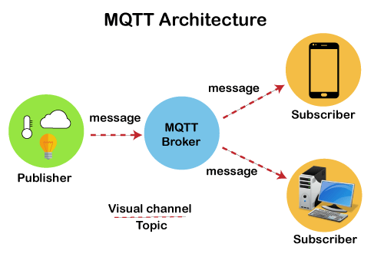

Message Queue Telemetry Transport Protocol (MQTT)

Slide 21
MQTT Features
Quality of Service Levels: A Quality of Service (QoS) level is simply an agreement between the sender and receiver of a message that guarantees the deliverability of said message.
Persistent Sessions
Last Will: A "last will" message is automatically sent to the MQTT broker if the client ungracefully disconnects. This allows the broker to easily and efficiently notify the other clients when one disconnects.
Works well over unreliable networks

Slide 22

Advanced Message Queuing Protocol (AMQP)
The defining features of AMQP are message orientation, queuing, routing (point-to-point and publish-and-subscribe), reliability and security.
The AMQP consists of a hard and fast of components that route and save messages within a broker carrier, with a set of policies for wiring the components together.

Slide 23
Advanced Message Queuing Protocol (AMQP)

Slide 24
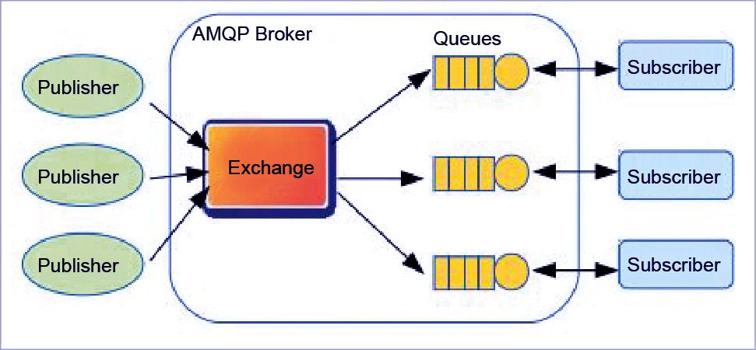
Advanced Message Queuing Protocol (AMQP)

Slide 25
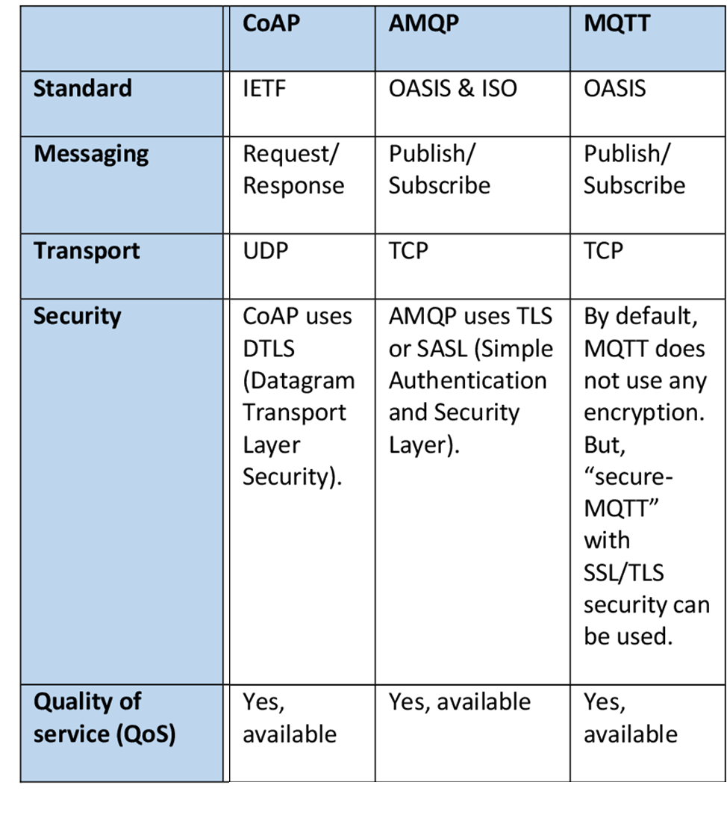
MQTT, CoAP, AMQP

Slide 26
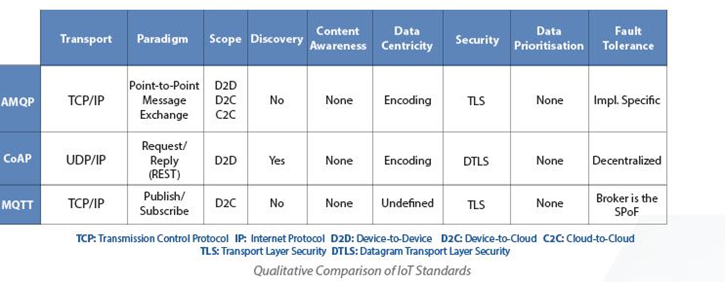
MQTT, CoAP, AMQP

Slide 27
Unit 6.5 Data transfer protocols used by IoT

